Slide 1



Salary Prediction using Linear Regression
Using Machine Learning to Predict Employee Salary Based on Experience
Notes:
1

Slide 2

Problem Statement
Predicting employee salaries is a common challenge for companies. HR departments need to estimate the correct salary for new employees based on their experience, but manual estimation is often inaccurate and inconsistent.
There is a need for a simple, data-driven model that can help automate this prediction process and reduce errors, saving both time and resources for organizations.
Notes:
2

Slide 3
Objective
The main objective of this project is to build a simple and accurate machine learning model using Linear Regression that can:
Analyze Past Salary Records
Understand Relationships
To understand historical compensation trends.
Between years of experience and salary.
Predict Employee Salary
Ai Data-Driven Decisions
Based on their accumulated experience.
Empowering organizations with smarter insights.
Notes:
3

Slide 4
Methodology
Data Collection
Data Preprocessing
A dataset with YearsExperience and Salary columns was gathered.
Checked for missing values and formatted the data appropriately.
Model Selection
Model Training
Linear Regression was chosen for its simplicity and effectiveness in numerical predictions.
The model learned patterns and created a best-fit line based on the dataset.
Model Testing & Prediction
Visualization
The trained model's accuracy was evaluated by predicting salaries for various experience levels.
A graph was plotted to visually represent the experience-salary relationship.
Notes:
4

Slide 5

Tools & Technologies
Programming Language:
Libraries Used:
Python
NumPy: Essential for efficient mathematical operations.
Pandas: Critical for data handling and comprehensive analysis.
Matplotlib: Utilized for creating insightful graphs and visualizations.
Scikit-learn: Provides the robust Linear Regression machine learning model.
Platform Used:
Google Colab Notebook (Cloud-based, no installation needed)
Algorithm:
Linear Regression — specifically chosen for predicting continuous numerical values.
Notes:
5

Slide 6
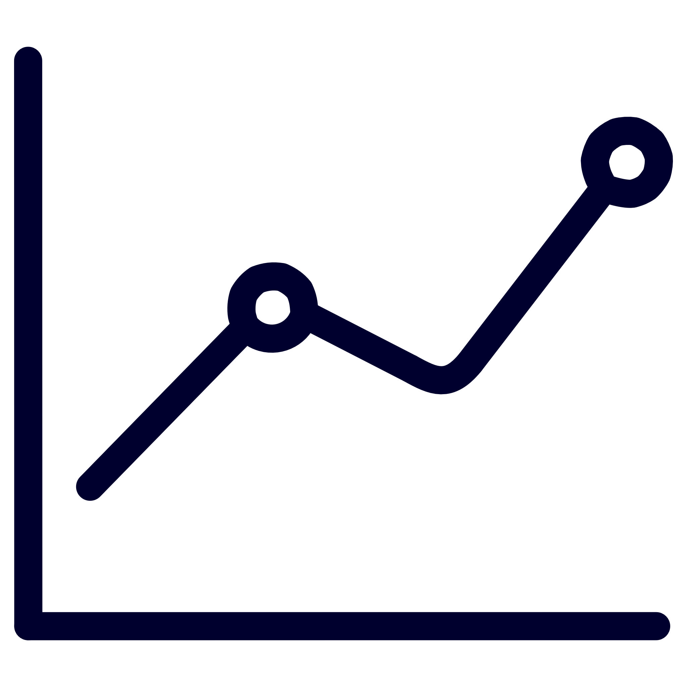




Expected Output / Results
Upon successful execution, the project is anticipated to yield several valuable outcomes:
Learned Relationship
The Linear Regression model will accurately capture the relationship between experience and salary.
Accurate Predictions
The system will predict salary with high accuracy for new experience inputs.
Clear Visualization
A graph will display a straight line, clearly representing the salary trend.
Empowered HR Teams
HR teams can use this model for fair and consistent salary estimations.
ML Application Demonstrated
The project will showcase machine learning's utility in simple business applications.
Notes:
6

Slide 7

Loading Dataset
import pandas as pd
df = pd.read_csv('/content/Salary_Data 23.csv')
print(df.head())
Imported pandas to handle the dataset.
Loaded the CSV file into a dataframe df.
Displayed the first 5 rows to understand the structure of the data.
Notes:
9

Slide 8

Checking Correlation (Heatmap)
import matplotlib.pyplot as plt
import seaborn as sns
corr = df.corr()
sns.heatmap(corr, annot=True, cmap='coolwarm’)
plt.title('Correlation Heatmap’)
plt.show()
Calculated correlations between numerical columns.
Heatmap shows the strength of relationship between YearsExperience and Salary.
Strong positive correlation indicates regression is suitable.
Notes:
8

Slide 9
Salary Distribution
plt.figure(figsize=(7,5))
plt.hist(df['Salary'], bins=10)
plt.title('Salary Distribution')
plt.xlabel('Salary')
plt.ylabel('Frequency')
plt.show()
Histogram shows how salary values are spread.
Helps identify dataset shape, outliers, and skewness.
Notes:
9

Slide 10
Splitting the Dataset
from sklearn.model_selection import train_test_split
X = df[['YearsExperience']]
y = df['Salary']
X_train, X_test, y_train, y_test = train_test_split(
X, y, test_size=0.2, random_state=42
)
print("X_train shape:", X_train.shape)
print("X_test shape:", X_test.shape)
print("y_train shape:", y_train.shape)
print("y_test shape:", y_test.shape)
Input(feature)=YearsOfExperience
Output (target) = Salary
Data split into 80% training and 20% testing.
Ensures the model is tested on unseen data.
Notes:
9

Slide 11
Created a Polynomial Regression model (degree 2) for improved flexibility.
Training the Models
from sklearn.linear_model import LinearRegression
from sklearn.preprocessing import PolynomialFeatures
# Linear Regression
lr = LinearRegression()
lr.fit(X_train, y_train)
# Polynomial Regression (degree 2)
poly = PolynomialFeatures(degree=2)
X_poly = poly.fit_transform(X_train)
pr = LinearRegression()
pr.fit(X_poly, y_train)
print("Models trained successfully.")
Trained a Simple Linear Regression model.
Notes:
9

Slide 12
Created a Polynomial Regression model (degree 2) for improved flexibility.
Predictions & Evaluation
from sklearn.metrics import r2_score, mean_absolute_error, mean_squared_error
lr_pred = lr.predict(X_test)
pr_pred = pr.predict(poly.transform(X_test))
lr_r2 = r2_score(y_test, lr_pred)
pr_r2 = r2_score(y_test, pr_pred)
print("Linear Regression R²:", lr_r2)
print("Polynomial Regression R²:", pr_r2)
best_model_name = "Polynomial Regression" if pr_r2 > lr_r2 else "Linear Regression"
print(f"Best performing model based on R-squared: {best_model_name}")
Predicted salaries using both models.
Calculated R² score for accuracy comparison.
Higher R² = better model performance.
Selected the best model between Linear & Polynomial.
Notes:
9

Slide 13
Created a Polynomial Regression model (degree 2) for improved flexibility.
Graph: Linear Regression
plt.scatter(X_test, y_test, label='Actual Data')
plt.plot(X_test, lr.predict(X_test), label='Linear Regression', linewidth=3)
plt.xlabel("YearsExperience")
plt.ylabel("Salary")
plt.title("Linear Regression - Actual vs Predicted")
plt.legend()
plt.show()
Notes:
9

Slide 14
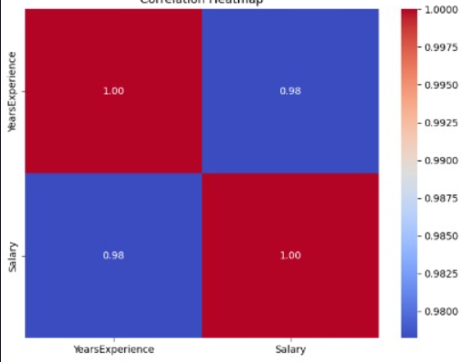

Slide 15
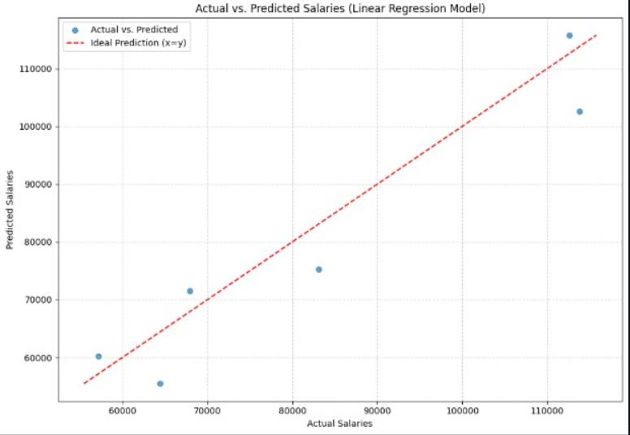

Slide 16
